Slide 1
Embedded lab presentation b3
Done by: abbas barada, Arlind karriqi, md tasnim muaz.

Slide 2
overview
Introduction
Task 1
Task 2
Task 3
Task 4
Task 5

Slide 3
Introduction
This project focuses on designing a safe and efficient traffic light system with a pedestrian crossing. Using Arduino, timers, and communication between two boards, the system manages vehicle flow while allowing pedestrians to request a safe crossing.

Slide 4
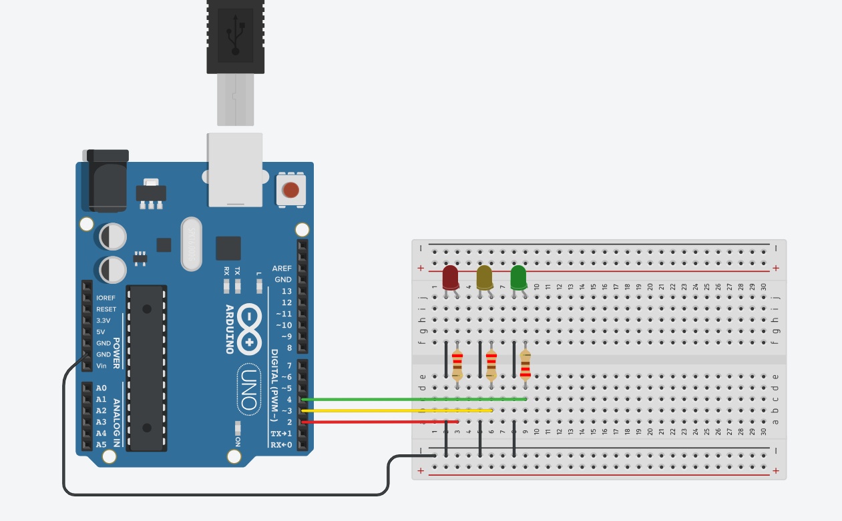
Task 1
Controls 3 LEDs: red, yellow, green.
Uses a state machine (RED → YELLOW → GREEN).
Each state turns on the correct LED for a set time.
The cycle repeats continuously.

Slide 5
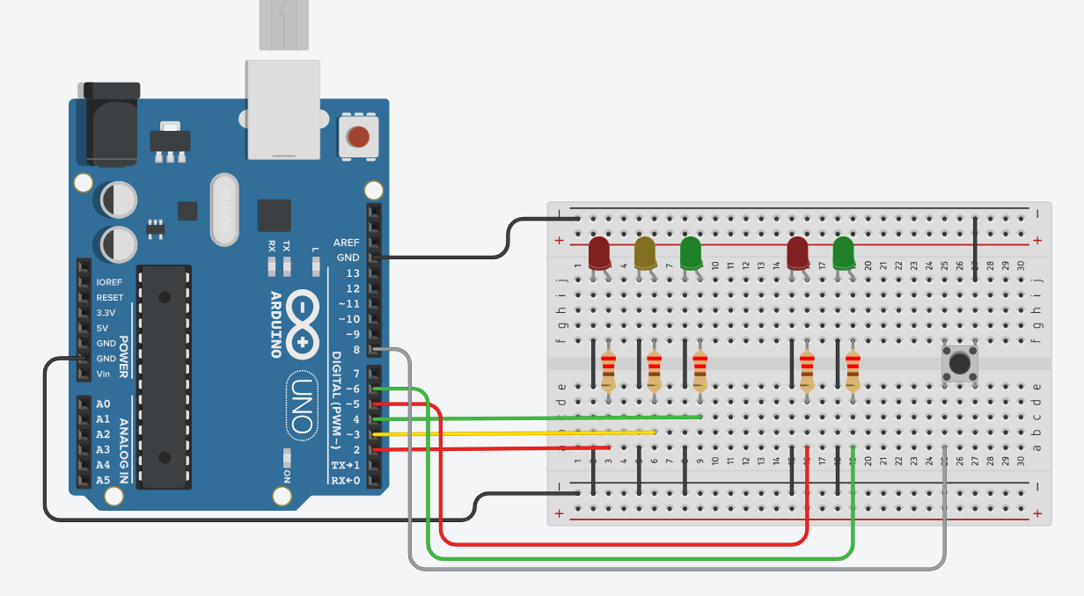
Task 2
Uses 4 traffic LEDs (red/yellow/green) + 2 pedestrian LEDs.
A button lets pedestrians request crossing.
Program runs a state machine: GREEN → YELLOW → RED → RED→GREEN.
After pedestrians finish, traffic returns to green automatically.
Timers control how long each light stays on.

Slide 6
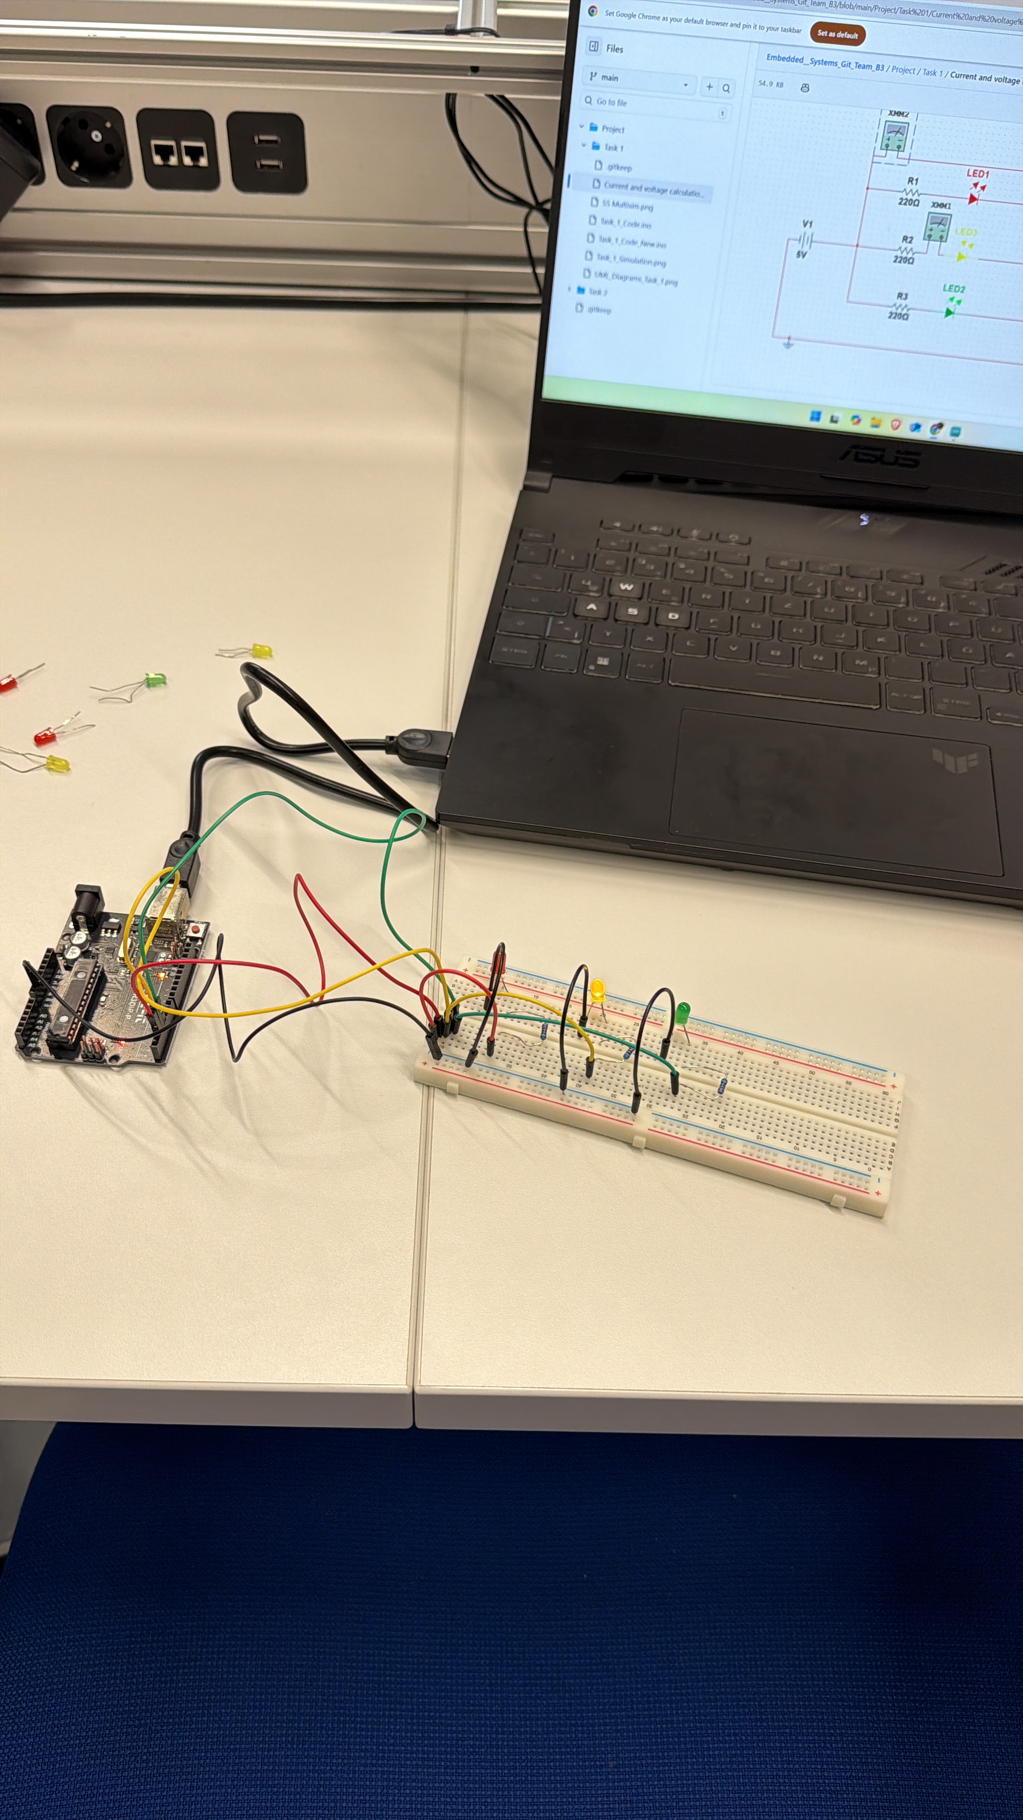
Task 3
In task 3 we implemented the simulated circuit and code from task 1 in an actual Arduino setup.

Slide 7
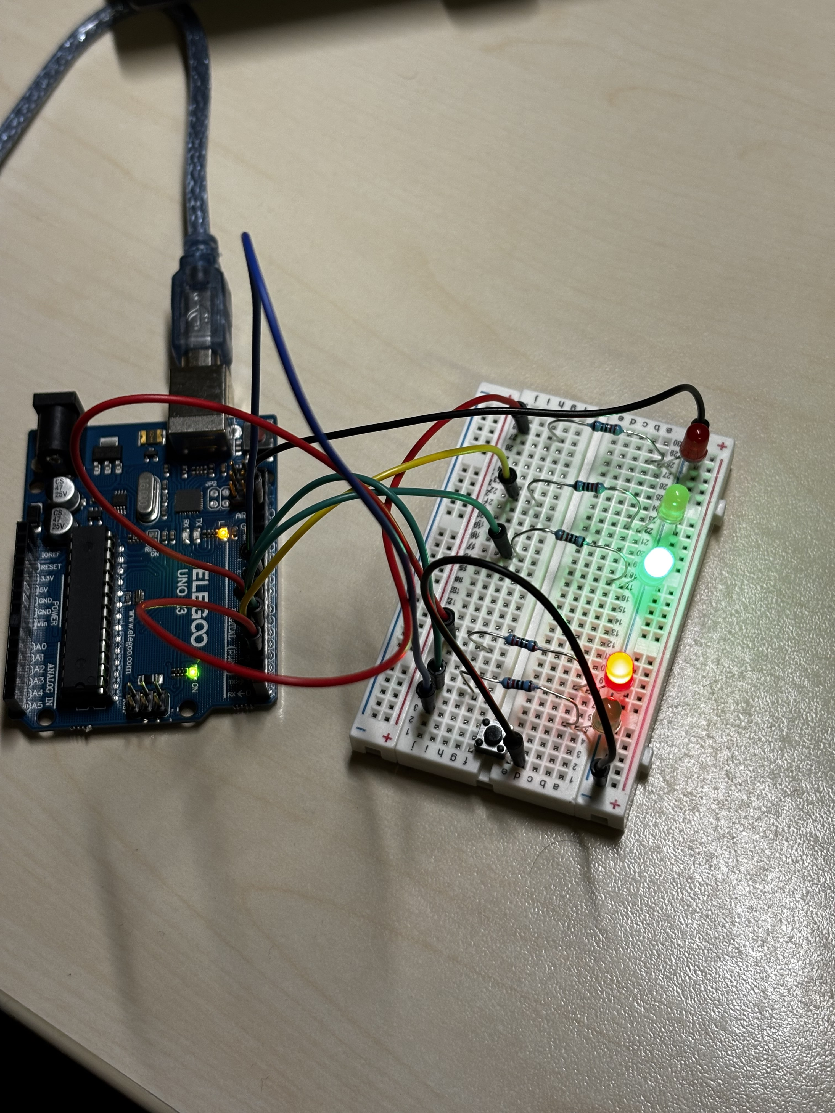
Task 4
In task 4 we implemented the simulated circuit and code from task 2 in an actual Arduino setup.

Slide 8
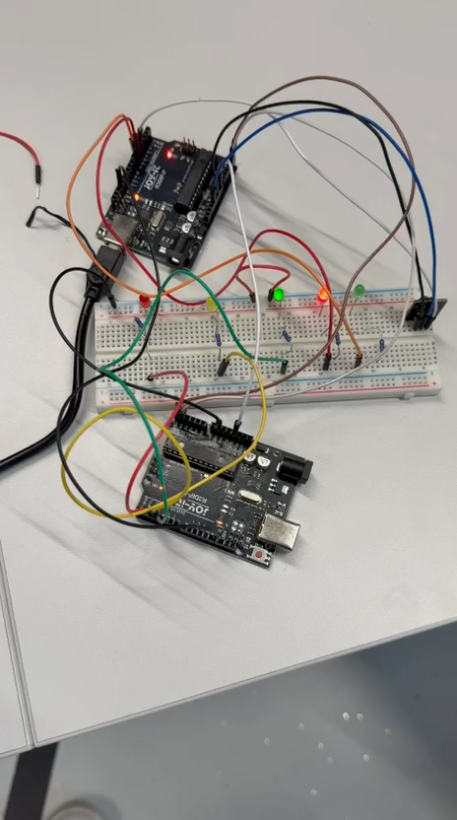
Task 5
Two Arduinos communicate using I2C (Master controls traffic lights, Slave handles button + pedestrian LEDs).
Slave Arduino sends button press to Master.
Master Arduino runs a state machine (GREEN → YELLOW → RED → RED→GREEN).
When RED, Master sends pedestrian green signal to Slave.
Slave switches pedestrian LEDs based on Master’s command.

Slide 9

Summary
Built a basic traffic light using a state machine. Added a pedestrian button and LEDs with safe timing. Split the system into Master (traffic lights) and Slave (button + pedestrian LEDs) Arduinos. Used I²C so both boards communicate and stay synchronized. Final system lets pedestrians request crossing and ensures safe traffic flow.

